Slide 1

INSTITUTE UIE
DEPARTMENT ACADEMIC UNIT-1
Bachelor of Engineering (Computer Science & Engineering)
Subject Name Introduction Electrical & Electronics Engineering
Subject Code 23EC-101
Prepared By
Dr. Shikha
Unit-2 Chapter-1
Combinational and Sequential Circuits
Lecture No. 2.1.1
COMBINATIONAL CIRCUIT
DISCOVER . LEARN . EMPOWER

Slide 2
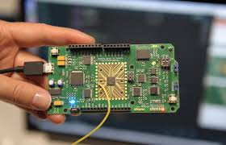
Course Outcome
CO Number | Title | Level
CO1 | To identify the different types of electrical elements and the basic op-amp circuit elements and to illustrate the various types of motors, transducers. | Remember
CO2 | To understand basic principles of transformers, transducers, op-amps, DC and AC motors and to compare the different methods for analysing electrical and magnetic circuits. | Understand
CO3 | To derive the relationships between parameters in electric and magnetic circuits and motors and to determine specifications of op-amps. | Analyze
CO4 | To solve the basic problems related to electric circuits, magnetic circuits and motors and to assess the characteristics of different configurations of op-amps. | Evaluate
CO5 | To design the different applications of transducers, motors as well as the op-amps like adders, subtractor and comparators. | Create
Figure 1.1 Practical application of Combinational circuit [1]
COMBINATIONAL CIRCUITS

Slide 3
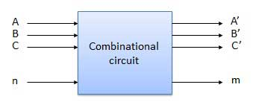
COMBINATIONAL CIRCUITS
Combinational circuit is defined as a circuit in which different gates are combined to obtain a meaningful output.
The output of combinational circuit at any time instant depends only on the present input level.
It does not require a memory. Thus, previous input state does not affect the present output state of the circuit.
Such circuits can have multiple number of inputs and outputs.

Slide 4
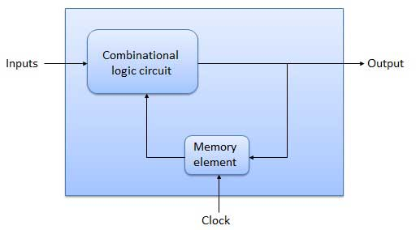
SEQUENTIAL CIRCUITS
Sequential circuit is a circuit which consists of Input, Combinational circuit, Memory element and Output.
It has a memory, thus the output can vary based on previous inputs as well.
Hence, sequential circuit uses previous input, clock, a memory element and output
Figure 2 Sequential circuit

Slide 5
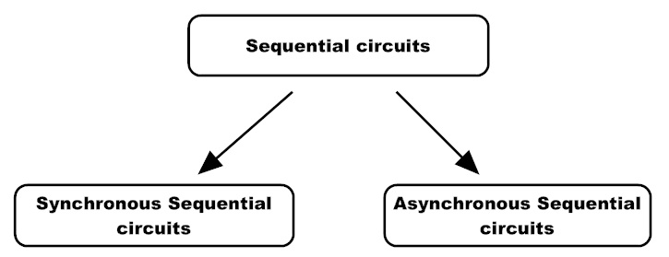
SEQUENTIAL CIRCUITS
Examples are as follows:
Flip flops
Latch
Registers
Counters
Figure 3: Types of Sequential Circuit

Slide 6
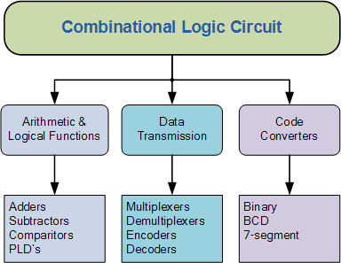
COMBINATIONAL CIRCUITS
The following are examples of combinational circuit:
Half adder
Full adder
Half subtractor
Full subtractor
Encoder
Decoder
Multiplexer
De-multiplexer etc.
Figure 4 Types of Combinational Circuits

Slide 7
TYPES OF ADDERS
BINARY ADDER
HALF ADDER
FULL ADDER
PARALLEL ADDER
RIPPLE CARRY
LOOK AHEAD CARRY
CARRY SAVE
Figure 5 Types of Adders

Slide 8
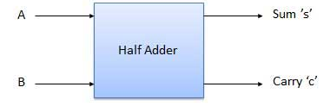
HALF ADDER
Half adder is a combinational logic circuit which add two input binary bits and will result sum and carry as output variables.
Figure 6 Block diagram of Half Adder

Slide 9
HALF ADDER
TRUTH TABLE
A | B | S | C
0 | 0 | 0 | 0
0 | 1 | 1 | 0
1 | 0 | 1 | 0
1 | 1 | 0 | 1
Figure 7 Block diagram of Half Adder
Boolean Expression
S = A’B + AB’
S= A⊕B C=A.B

Slide 10
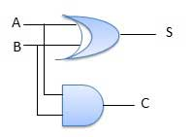
HALF ADDER
Realization of the Boolean Expression
Figure 8 Logic diagram of Half Adder

Slide 11
Assessment Pattern
Differentiate between combinational and sequential circuits with example
Derive the Boolean expression for Half adder
Realize half adder using BASIC gates

Slide 12
APPLICATIONS
Calculators.
To perform additions on binary bits, the Arithmetic and Logic Unit present in the computer prefers this adder circuit.
In design of Full Adder.
To calculate the addresses and tables these circuits are preferred.

Slide 13
REFERENCES
https://ethz.ch/content/dam/ethz/special-interest/infk/inst-infsec/system-security-group-dam/education/Digitaltechnik_17/0a_CombinationalCircuits.pdf
https://www.tutorialspoint.com/computer_logical_organization/sequential_circuits.htm
https://www.google.com/search?q=combinational+circuits+in+digital+electronics&source=lnms&tbm=isch&sa=X&ved=0ahUKEwj526-wnv3iAhWSXCsKHf77AtQQ_AUIESgC&biw=1366&bih=657#imgrc=v4c5n7-dy4fzAM
https://www.tutorialspoint.com/computer_logical_organization/combinational_circuits.htm
https://www.google.com/url?sa=i&url=https%3A%2F%2Fwww.electronicshub.org%2Fsequential-circuits-basics%2F&psig=AOvVaw2X9fQUT0TGHCoXGGqT1yoD&ust=1595874213198000&source=images&cd=vfe&ved=0CAIQjRxqFwoTCNi0l_nE6-oCFQAAAAAdAAAAABAQ
Mano,Morris, Digital Design, Prentice Hall of India.
Fletcher, An Engg. Approach to digital design, Prentice Hall of India.

Slide 14
THANK YOU

